Slide 1
ABNORMAL BEHAVIOUR DETECTION IN SMART HOMES
-Amruta Ranade
Under the Guidance of Prof.S.P.Shintre

Slide 2
1. INTRODUCTION
Artificial intelligence (AI) is the intelligence exhibited by machines or software. Also it is responsible for intelligent behaviour of computer systems.
There are various applications of AI including speech recognition, handwriting recognition, smart homes, intelligent robots etc. Smart homes have become increasingly popular in the past few years.
Smart homes add convenience to your daily life. Having a smart home lets you do a lot of the things that you would normally do.
Advantages of Smart homes: security, operational cost saving, flexibility, time reduction for doing a particular task etc.
The tempting vision of smart control over environments motivates home owners to integrate automation technology into their homes with the promising effects of increased comfort, peace of mind and economic benefits. [1]

Slide 3
CONTINUED…
Various socially relevant applications that can be designed in smart homes such as elderly care, child care, energy efficiency, surveillance etc.
Smart environments are able to recognize the ongoing activity of the occupant by applying reasoning techniques dynamically over the real time data captured from the environment.[2]
For elder care, , it is important to develop unobtrusive, affordable, computationally inexpensive, smart home technologies if there is any abnormal activity.

Slide 4
SOLUTION
Differentiation between normal and abnormal activities should be done in smart homes environment, where elderly people are monitored by a system that can alert medical professionals if abnormal behaviour is detected.
In order to represent and recognize complex activities and behavioural hierarchy, Hierarchical Hidden Markov Model (HHMM) can be used.

Slide 5
CONCEPTS USED
A description logic learning problem to find a concept (description) is defined by a tuple (K,(E+,E-)), where K is a knowledge base, E+ is set of positive examples and E- is set of negative examples such that E + ∩ E − = ∅.
Consists mainly 3 steps: specialization, reduction and generalization (aggregation)
Concepts used:
Irrelevant concept: For a given LP=K,(E+,E-), If description C covers none of the positive examples.
Partial definition: For a given LP=K,(E+,E-), if it is correct (i.e. covers no negative example) and not irrelevant (covers some positive examples).
Selection of description in search tree is done by using expansion score.

Slide 6
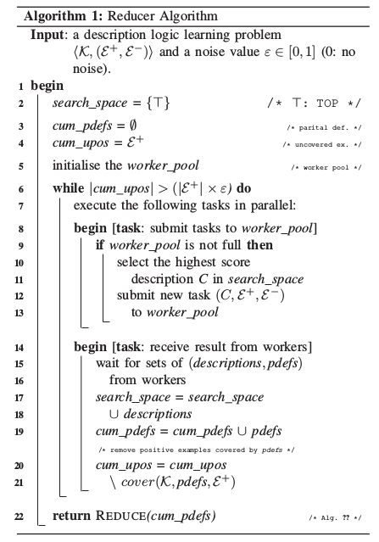
REDUCER ALGORITHM
[3]

Slide 7
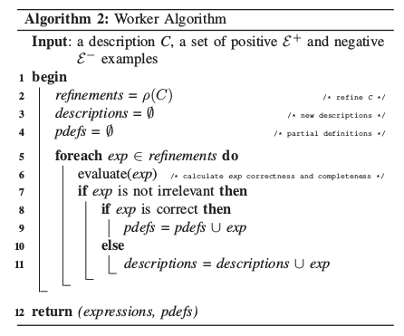
WORKER ALGORITHM
[3]

Slide 8
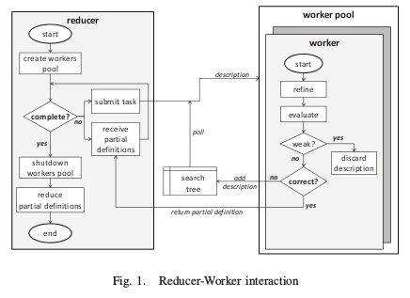
PARALLEL HYBRID APPROACH
[3]

Slide 9
HHMM
Hierarchical Hidden Markov Model(HHMM) is one of the earlier extensions of the Hidden Markov Model(HMM) and is an improvement over HMM to represent and recognize complex activities.
HMM is inadequate to model complex activities because they cannot characterize the hierarchy and shared structure naturally embedded in the activities.
It helps to model and learn sequential behaviours, to detect and predict abnormal behaviours with a home network system.
HHMM allows to incorporate the structure of the behavioural hierarchy and classify it into normal and abnormal behaviour using the time span of user's behaviour and the relevance of other activities.
Definition:A discrete HHMM is formally defined by a 3-tuple <C, y, 8>: a topological structure C, an observation alphabet y, and a set of parameters e. The topology C specifies the number of levels D, the state space at each level, and the parent-children relationship between levels d and d+1.
[5]

Slide 10
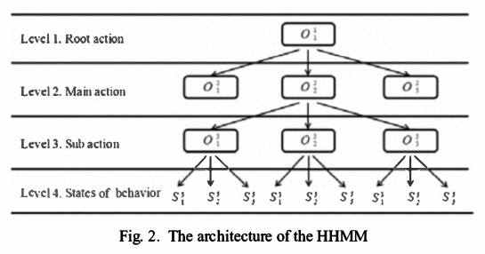
HMMM ARCHITECTURE
[5]

Slide 11
VITERBI ALGORITHM
It consists of 4 steps:
Finding normal behaviour pattern 01: Normally a main action lasts longer than a sub-action. We found that 65% of sub-actions are over when the main action is finished. It forms Normal behaviour Category01(NBC01).
Finding exceptional behaviour pattern: We found that 35% of the time, sub-actions continued after the main actions were finished. It forms Exceptional behaviour Category (EBC) which is further divided into Normal behaviour Category02 (NBC02) and Abnormal Behaviour Category (ABC), based on whether or not they were associated with other main actions.
Finding normal behaviour pattern02: 15% of the patterns in EBC were related to other main actions and categorized as Normal behaviour Category02(NBC02).
Finding Abnormal behaviour pattern: We found that 20% of the patterns in EBC were not related to other main actions. These were classified as Abnormal Behaviour Category(ABC).
[5]

Slide 12
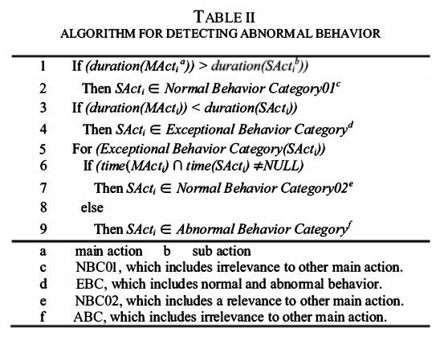
CONTINUED…
[3]
[5]

Slide 13
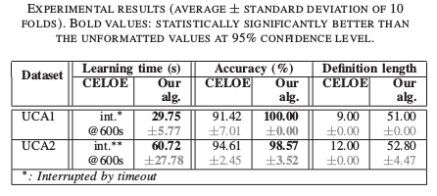
RESULTS
For Description Logic Learning:
Experimental values[3] taken at 95% confidence level show increase in accuracy, definition length and decrease in learning time.

Slide 14
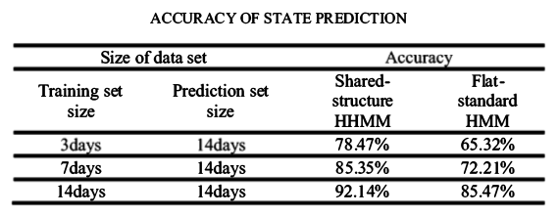
CONTINUED…
For HMMM:
Observation[5] taken over a prediction set for 14 days showed that HMMM has more accuracy than that of Flat HMM.

Slide 15
CONCLUSION
As the Description Logic Learning algorithm uses parallelization, multi-core machines were able to be utilized, which fastens the learning process. Also it produces promising results in terms of both accuracy and learning time.
HHMM detects complex activities more efficiently than other Hidden Markov Models as it uses shared structures. The behaviour detection accuracy of HHMM is higher than that of flat HMM.

Slide 16
REFERENCES
[1] Christian Reinisch, Mario J. Kofler, Wolfgang Kastner; ; Vienna University of Technology, Automation Systems Group; “ThinkHome: A Smart Home as Digital Ecosystem”, IEEE 2010
[2] K.S.Gayathri, Susan Elias, S.Shivashankar; “Composite activity recognition in smart homes using Markov Logic Network”, IEEE 2014
[3] An Cong Tran; “Application of Description Logic Learning in Abnormal behaviour Detection in Smart Homes”, IEEE 2015
[4] A. C. Tran, S. Marsland, J. Dietrich, H. W. Guesgen, and P. Lyons, “Use cases for abnormal behaviour detection in smart homes,” in Aging Friendly Technology for Health and Independence. Springer, 2010, pp. 144–151.
[5] Wonjoon Kang, Dongkyoo Shin, Dongil Shin; “Detecting and Predicting of Abnormal behaviour Using Hierarchical Markov Model in Smart Home Network”, IEEE 2010
[6] J. Lehmann and P. Hitzler, “Concept learning in description logics using refinement operators,” Machine Learning, vol. 78, no. 1, pp. 203–250, IEEE 2010.

Slide 17
THANK YOU…!!

